Slide 1
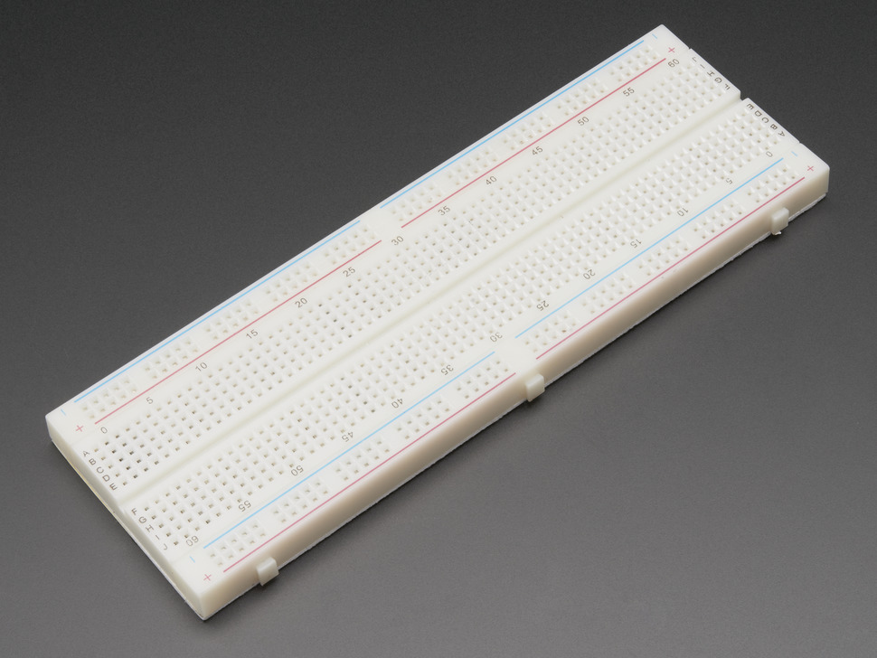
6.1 Breadboard
Dhruvin modi – 201806100110016
Ria soni - 201806100110017

Slide 2
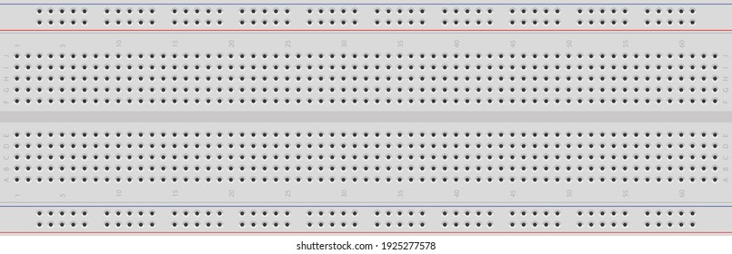
What is breadboard?
Its a rectangular piece of plastic with a grid of holes that allows you to easily and quickly build electronic circuited by pushing electronic components into the holes.
They are temporary work boards for functional version of electronic circuits.
Your company name

Slide 3
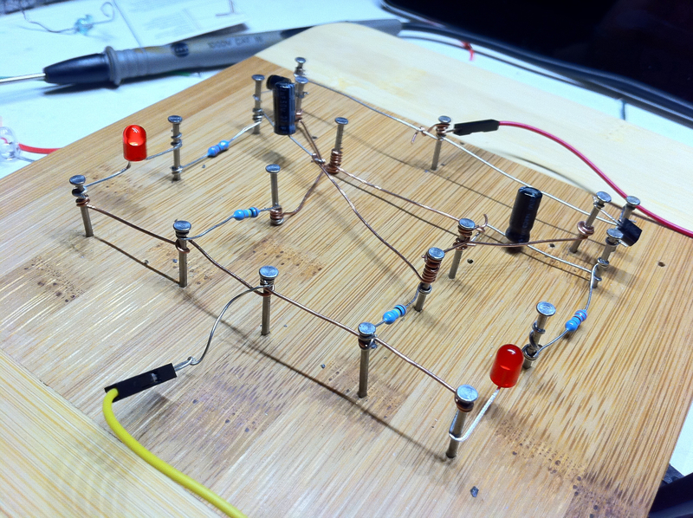
Where does this name came from?
Engineers working on electronics before 1970 they did not have the thing we call a solderless breadboard.
Instead, they would build electronics by literally hammering nails into a wooden board which is used to cut bread or fruits, etc.
The electronic parts would be nailed or glued to the board and electrical connections made by soldering or wrapping wire around the nails.
This was good for simple and small circuits because the components were large but for complex one and by the time the components got smaller and smaller this became difficult as you couldn't easily nailed them down to a chunk of wood.

Slide 4
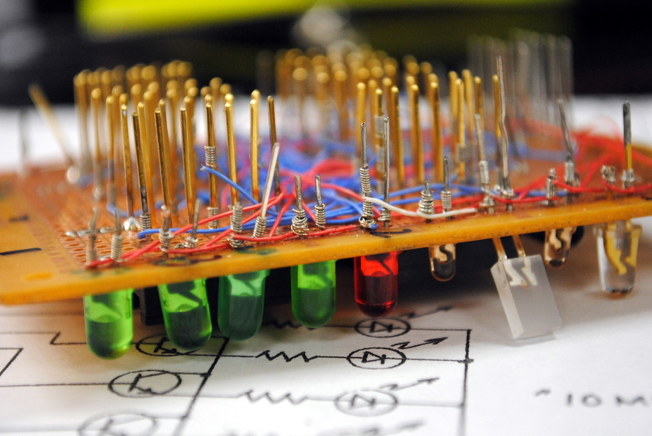
Continue
For a while in the 1960s to part of the 1980s, engineers and makers used some other techniques like wire-wrapping which solved the 'complex circuits' issue but was still semi-permanent.
With practice, wire-wrap prototyping could be fast but took a while to get used to:
parts were wrapped on the opposite side of the board so you would constantly flip back and forth.
undoing or fixing a wire wrap could be annoying if there were other wires wrapped onto the same pin.
reusing a wire-wrap board was a real pain since all the wires would have to be carefully unwrapped or cut.

Slide 5
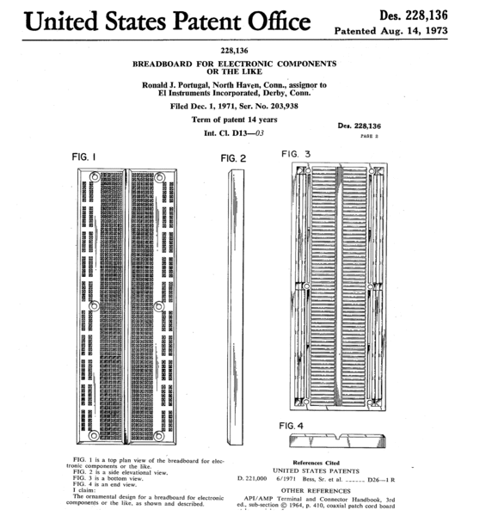
Continue
1971 - The Breadboard Is Invented! by Ronald J Portugal.
It was quickly called the "Solder-less" Breadboard because no soldering is required to use it, and then shortened to plain Breadboard since nobody uses a "solder-full" breadboard.

Slide 6
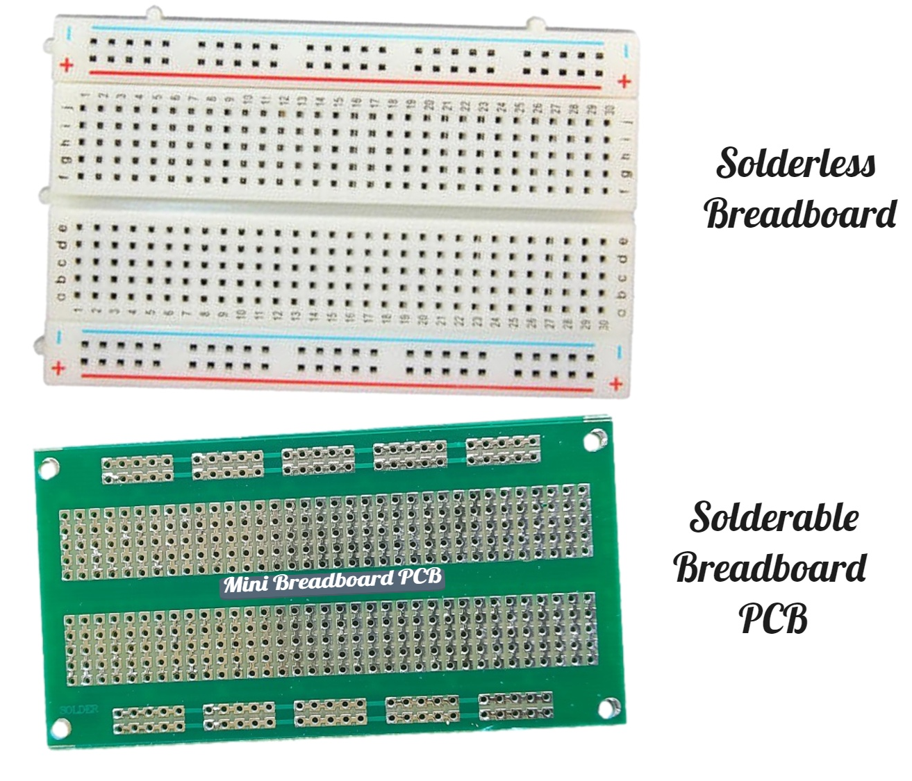
Types of breadboard
Breadboards are classified into two types like a solderless breadboard and a solder-able breadboard.

Slide 7
Solderless Breadboards
This is the most commonly used breadboard for prototyping as well as testing electronic circuits without soldering the components.
The circuits on these breadboards are not permanent so we can check & test the functionality of a circuit before confirming its design onto a PCB. These breadboards include rows & columns with holes that allow the leads of components & wire gauges.
If the terminal of the component does not place into the hole of a breadboard, then a connecting wire can be soldered to the lead of a component that will insert in the breadboard hole.
Solderless breadboards are typically rated for 1A @ 5V, or 5 W.
The electricity flows from the Battery's positive terminal to the negative. This means that at the top breadboard, the electricity passes from the resistor at first, then from the led, and then goes to the ground.
104/- big one

Slide 8

Solderless Breadboards
Advantage
Disadvantage
It doesn’t require soldering to connect the components on board.
If the circuit is not working properly then, we can easily check and rectify them by taken out the components & replace them easily.
Components that are connected to the breadboard can come loose once the breadboard is pushed or moved.
These breadboards are restricted to below or 10 MHz frequencies.

Slide 9
Solderable Breadboard
These types of breadboards offer a permanent setup for your electronic circuits.
This kind of breadboard gives a stronger setup. It includes holes for electronic components including copper tracing.
These components can be soldered using soldering iron for soldering the components to the breadboard so that an electrical connection can be formed through the copper tracing.
jumper wires are needed for soldering separately in between these components to make a lane to permit the flow of current. These types of breadboards are available in different sizes based on the requirement.
average maximum voltage that a breadboard can handle is 36 volts, and the maximum current that it can handle is 2 amps. So, you will not have any problems running a voltage of 12 volts on your breadboard.
370/- large one

Slide 10
Solderable Breadboard
Advantage
Disadvantage
These breadboards are robust and your circuit will be very secured on this type of breadboard.
Less cost and saves time while designing a circuit.
If there is any error occurs in the circuit then de-soldering may cause damage to components.
This board cannot be reused.

Slide 11
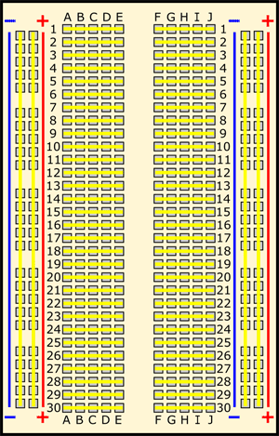
current flow

Slide 12
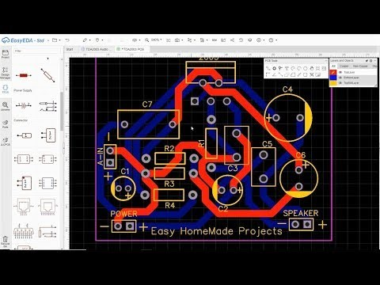
convert breadboard circuit to pcb

Slide 13

Thank You

